Slide 1
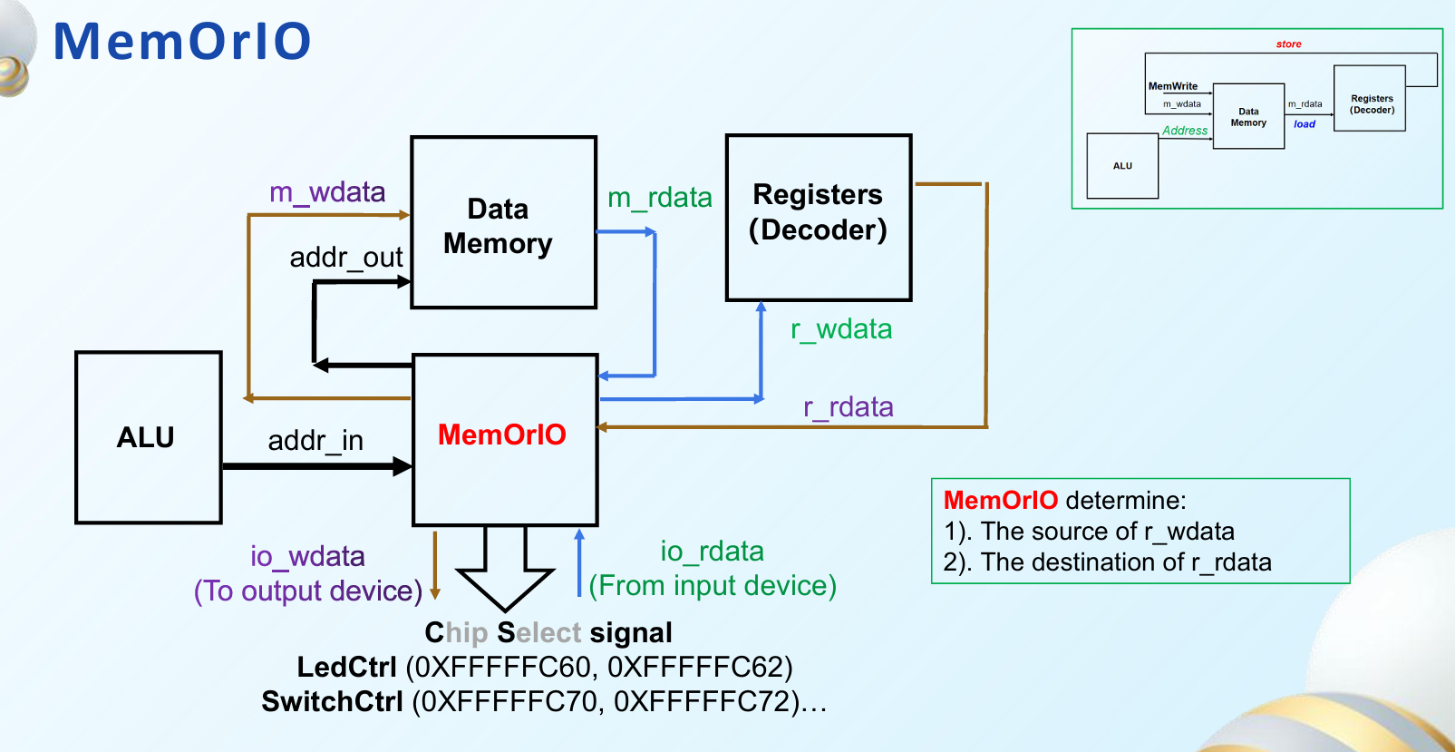
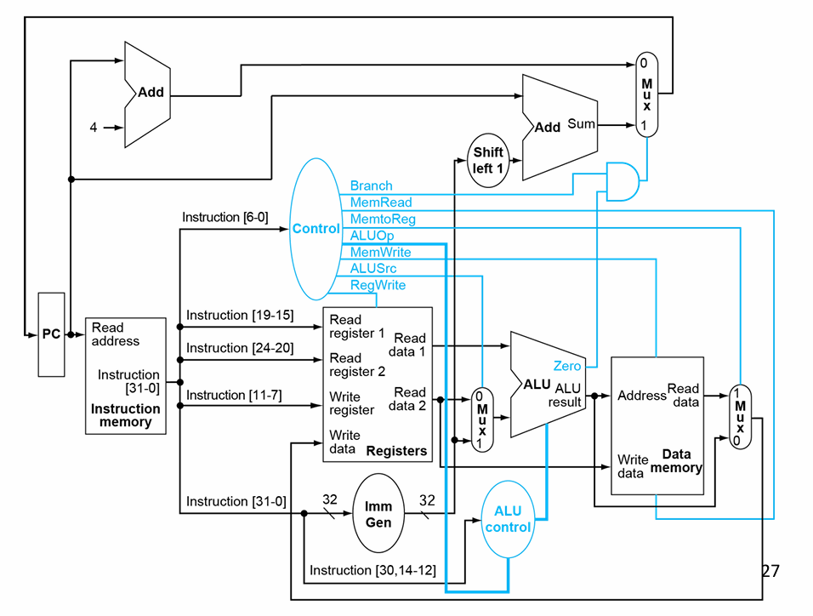
io_write_en
io_read_en
branch_taken
mem_read_en
mem_to_reg_en
alu_op
mem_write_en
alu_src
reg_write_en
m_rdata
mem_or_io
addr_in
Address
Read
data
addr_out
r_rdata
Write
data
m_wdata
Data
memory
r_wdata
io_wdata
io_rdata

Slide 2
UART input:
upg_rst_i, // UART编程复位
upg_clk_i, // UART编程时钟
upg_wen_i, // UART编程写使能
[13:0] upg_adr_i, // UART编程地址
[31:0] upg_dat_i, // UART编程数据
upg_done_i // UART编程完成
io_write_en
io_read_en
branch_taken
mem_read_en
mem_to_reg_en
alu_op
mem_write_en
alu_src
reg_write_en
m_rdata
mem_or_io
addr_in
Address
Read
data
addr_out
Write
instruction
r_rdata
Write
data
m_wdata
Data
memory
URAT input
(UART地址输出最高位为 0 )
ALU unit
URAT input
(UART地址输出最高位为 1 )
r_wdata
io_wdata
io_rdata
kick_off
(仅在top中影响对应模块的使能信号)

Slide 3
